Slide 1
Experimental Design
Joris De Wolf for VIB
Online, April 1 , 2020
www.Highwoods.be
joris.dewolf@highwoods.be

Slide 2
What are we trying to achieve in this course ?
To explain the underlying principles and concepts of experimental design, rather then providing techniques or recipes
To see how these principles translate in good designs
Point at the importance of the research context
Apply these to biological research
Learn to analyse and interpret data from experiments
Do this in an interactive way and learn through examples
Introduction

Slide 3
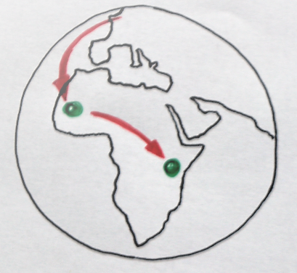
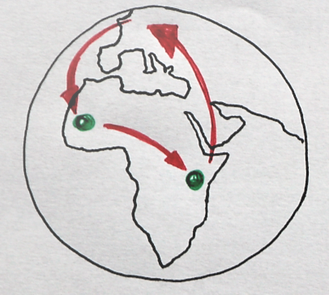
1989
Bio engineer
Tropical Agronomy
Phytopathology
1992
Senegal
Ecology
Multivariate Statistics
1994
80% researcher/
20% statistician
Experimental Design
Field trials
Kenya
Agroforestry
80% statistician/
20% researcher
(breeding, plant physiology,
N-fixation, P-availability, sociology,...)
2001
2000
CropDesign – Private sector/ spinoff VIB
Experimental Design
Research strategy
R Programming
Flemish Institute Nature conservation and Forestry
Data management
Transgenic breeding
High throughput screening and automation
Automated Imaging
Research strategy
Field trials
Optimization of research resources
PhD Applied Statistics
2006
CropDesign bought by BASF
Product development
Leading statistics department
2016
GSK Vaccines
Consultancy
Technical Research and Development
Process design
Statistical advice small biotech companies
Courses
2018 Consultancy
Statistical advice small and large biotech and pharma companies

Slide 4
Assignment 1

Slide 5
You receive this in your mail box:
What advize do you give me?

Slide 6
Part 1
The basis

Slide 7
Research strategy/
getting the question clear
Why are we doing experiments?
Important concepts
How to ensure an experiment fulfils concepts
Constraints of Data analysis
Why are we doing experiments and not something else?
Why are experiments able to deliver?
How did researchers do this before 1980 ?
What about now?
More flexibility

Slide 8
Why are we doing experiments ?

Slide 9
Research cycle
Testable hypotheses
Designed experiment
Research question
Execution/
data collection
Communication/
action/decision
Conclusion
Data analysis

Slide 10
When is an experiment well-designed ?

Slide 11
Design experiments such that
They answer the right question properly
They can be analyzed and provide unambiguous answers
They are efficient

Slide 12
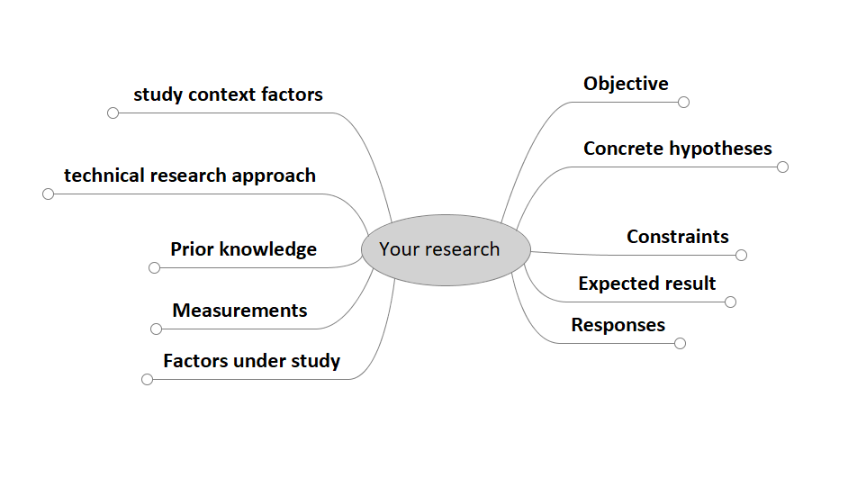
From research question to experiment
Many points to need to be clarified before starting.
Introduction

Slide 13
From research question to experiment

Slide 14
The stage of the research
Generalizability
Precision - Specificity
Learning – Testing –
Proving - Understanding
Using - Applying – Forecasting – Next Steps
Research path
Introduction

Slide 15
The stage of the research
Generalizability
Precision - Specificity
Tight control – articifical – miminize variability – focus on estimate of effects
Allow variability - representative – robustness – spread of effects
Introduction

Slide 16
How did we do with our first assignment?
Introduction

Slide 17
Why experiments and
why not something else ?

Slide 18
Is there an alternative ?
Observational studies
Measure existing phenomena
Real world
Sampling
Often broader and less specific
Experiments
Purposefully set-up
Artificial setting
Manipulation
Clear and narrow objective
Different analysis methods, different objectives, different inference
Introduction

Slide 19
Why experiments and not just observing ?
Because experiments provide:
More information per measurement point (efficiency)
Proof of causation
Introduction

Slide 20
Why not experiments in some cases ?
Impossible to do: physical impossible, expensive, unethical, too big, too long,...
More representativeness of real situation needed
Still lacking basic knowledge about subject
Allow serendipity
Introduction

Slide 21
Why can experiments
provide more information
proof causation
Some important concepts...

Slide 22
Essential concepts:
Randomisation
Replication
Orthogonality
+ some handy tools:
Balancing
Blocking
Random effects

Slide 23
Randomisation
Assigning at random all levels of all factors or combinations of them to an experimental unit that is the subject of a single datapoint in the analysis
active, not taking things as they are
entirely by chance
ALL factors, also non-experimental ones including preparation and measurements
independent observations, aggregation if needed
Ensures the proof of causation
Often we are happy with “almost entirely random”
Sometimes not possible (consequences...)
Introduction

Slide 24
Replication
Repeating to ensure we haven’t missed important factors for the causation part
Repeating to capture the remaining variability to enable to get an idea about the uncertainty
Plays at the unit to be used for data analysis (see also randomization)
Introduction

Slide 25
Orthogonality
Uncorrelated factors
Designs in which impact of one factor is not influenced by another factor
Important for the analysis and inference
A simple fertilizer trial
In a health survey factor ‘smoking’ is not-orthogonal with factor ‘getting sufficient exercise’.
It will be difficult/impossible to separate their effects. These factors are confounded.
 |  | N
 |  | 0 | 15 | 30
P | 0 | 2 | 2 | 2
 | 5 | - | 2 | 2
 | 10 | - | 2 | 2
 |  | N
 |  | 0 | 15 | 30
P | 0 | 2 | 2 | 3
 | 5 | 2 | 2 | 3
 | 10 | 2 | 2 | 3
Introduction

Slide 26
Balancing
Distributing factor levels equally
Simplest way to get orthogonality
Usually leads to the most powerful data analysis (expressed per data point)
Introduction

Slide 27
Blocking
Grouping to create more homogenous sets of units that come from a population affected by uninteresting but important sources of variability
Within a block, units are more equal (and even considered the same) than units from different blocks
A mean to reduce the remaining uncontrollable variability (see later)
Introduction

Slide 28
Covariates
Factors that are not the main objective of the experiment, but may affect the observations.
Can act directly on response, can alter the response to experimental factors or can change variability.
Are controllable or measurable
We may do something intelligent with them at the moment of data analysis
Introduction

Slide 29
Constraints,
the old days and the more recent days

Slide 30
Constraints old days
For easy calculation at the data analysis stage, designs need to be perfectly orthogonal and balanced.
Only a limited number of designs fulfil these criteria, are given a name and collected in recipe book style manuals.
Main role of statistician is to see if the appropriate design has been chosen (because plenty of recipes to choose from)
Situation is clear and easy
Introduction

Slide 31
Nowadays (since 30+ years)
Thanks to computers and new algortihms, we can live with almost-orthogonal designs, with unbalanced designs, incomplete blocks, dependent observations,...
Therefor there is far more flexibility in designing experiments.
This leads to the possibility to optimize the use of resources.
We have better options to fulfil other model assumptions.
We can perform more informative data analysis.
…
But less clear and easy. We need to think and understand…
Yet still a lot of old school designs (education, journal editors, research leaders, lack of modern statisticians...)
Introduction

Slide 32
Research strategy/
getting the question clear
Why are we doing experiments?
Important concepts
How to ensure an experiment fulfils concepts
Constraints of Data analysis
Why are we doing experiments and not something else?
Why are experiments able to deliver?
How did researchers do this before 1980 ?
What about now?
More flexibility

