Slide 1
Experimental Design
Joris De Wolf for VIB
Online, April 1 , 2020
www.Highwoods.be
joris.dewolf@highwoods.be

Slide 2
Part 2
From knowledge about variability to optimal design

Slide 3
Where is noise coming from?
Signal and noise
More efficient
Closer to our objectives
Power analysis
Can we manage the noise?
Can we use this to design better experiments?
How do we interpret the outcome of the power analysis
Randomisation schemes
An optimal design

Slide 4
Assignment 2

Slide 5
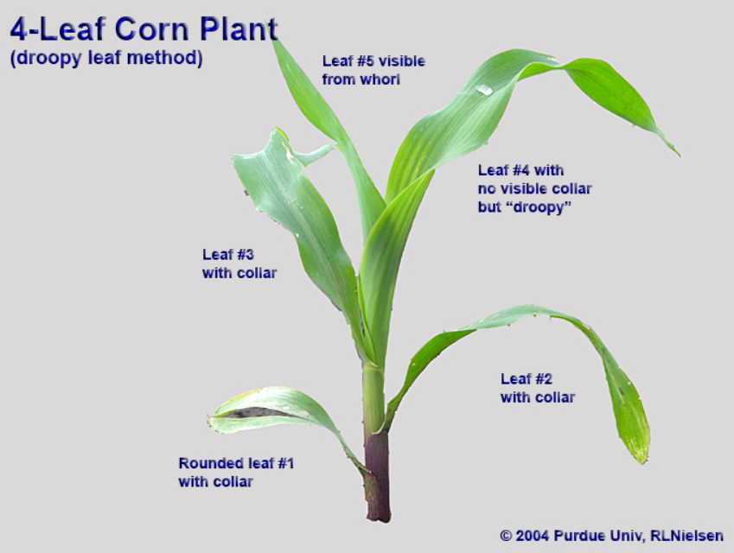
Greenhouse experiment
Each pot is filled with one of the two soil types R or P
In each pot 1 maize plant grows of either variety ‘fast’ or variety ‘slow’
The orange pot has variety ‘fast’ and soil P
Plants are grown till 4th leaf is fully expanded
Two samples are punched from the mid of the 3th leaf and of the 4th leaf
Samples of 1 leaf are bulked and the 6 phytochromes area quantified via spectrometry thrice.
Greenhouse table
light
Window facing South
irrigation
pot
List the factors that influence a PhyA1 measurements of the 4th leaf in the orange pot.
What information can help to estimate that value better?

Slide 6
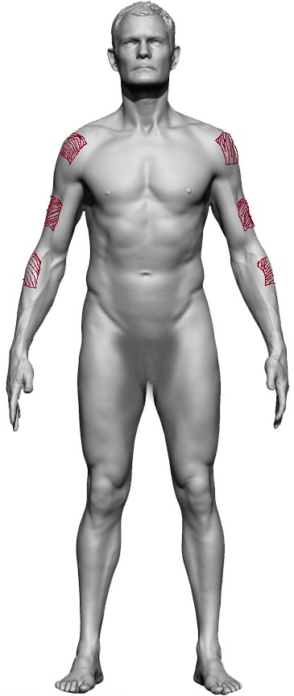
Skin care product experiment
6 healthy volunteers
Male 1 | Age 31 | Dark skin type
Female 1 | Age 42 | Dark skin type
Male 2 | Age 27 | Dark skin type
Male 3 | Age 29 | Light skin type
Female 2 | Age 24 | Light skin type
Female 3 | Age 38 | Light skin type
Can apply products on 3 spots on each arm
Apply products daily for a week,
expose arms to the sun and
assess after day 4 and after day 7: redness, itchiness and numbness.
After 2 months, a similar treatment period of a week
List the factors that influence the itchiness on the 7th day.
What information can help to estimate that value better?

Slide 7
data = signal + noise

Slide 8
Data = signal + noise
Estimate,
prediction
Uncertainty
(standard errors, confidence intervals)
Variability exists in all processes. Understanding and controlling variability is the key to success.
You can manage variability through your experimental design.
In some research noise is a nuisance. In other work it may be the major objective.
variability

Slide 9
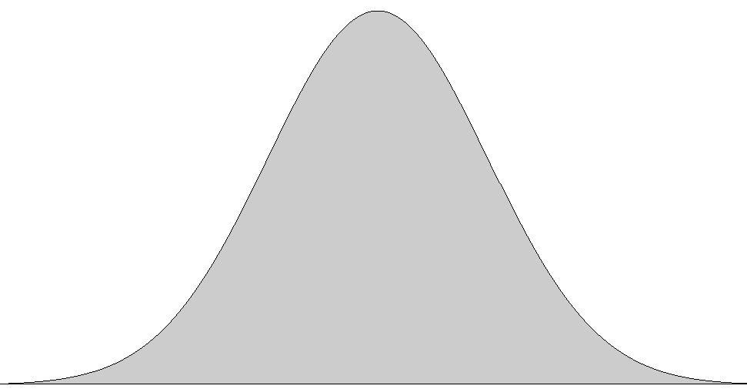
Data = signal + noise
A₁ vs A₂ : t-test
A₁ vs A₂ vs A₃ : anova
Anova is a standard method to compare several means.
So why is anova called anova?
=
+
+
+
R = T – A – U₁ – U₂
variability
interesting factor A
variability
uninteresting but known factor U₁
variability
uninteresting but known factor U₂
remaining unknown variability R
$$\frac{A}{R}$$
total variability T
$$\frac{A/levels}{R/df}$$
variability

Slide 10
Hence:
strategy to make experiments powerful
Increase degrees of freedom (number observations)
Decrease total variability
Identify as much as possible variability
in order to avoid it or
in order to get it out of the remaining variability
Start at the bottom
But go back to slide 15!
variability

Slide 11
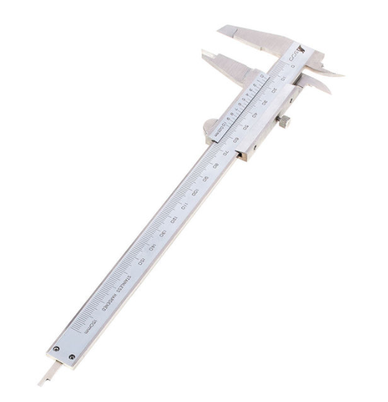
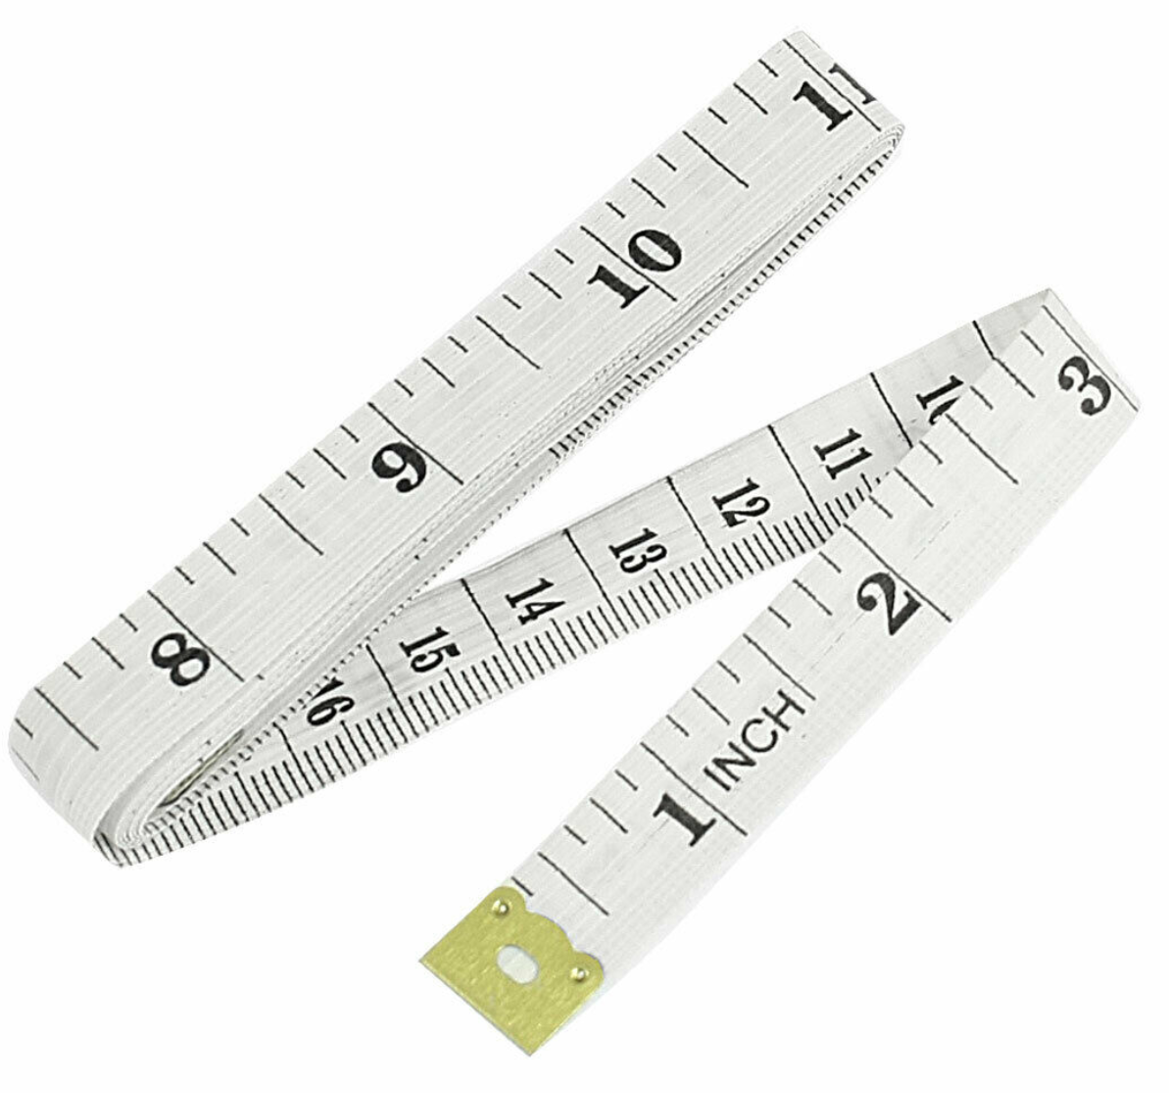
A special variance component:
The measurement
Usually lowest level variance component
Choose measurement carefully
Carefully means: balance representativeness and accuracy
Carefully means also : don’t overdo it nor sacrifice replication of the unit
Subsampling or repeated measurement are possible, but be aware during analysis!
Complex assays usually need research on its own, biggest source of issues in regulatory dossiers.
variability

