Slide 1
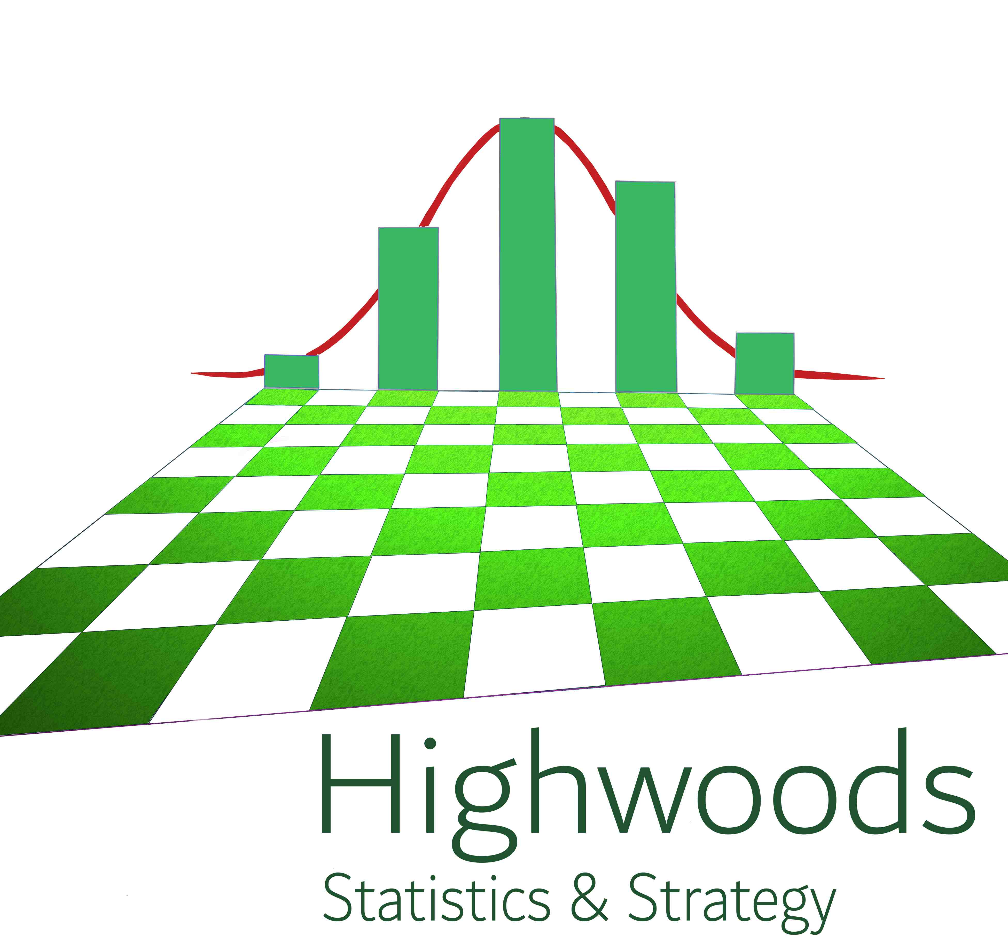
Experimental Design
Joris De Wolf for VIB
Online, April 1 , 2020
www.Highwoods.be
joris.dewolf@highwoods.be

Slide 2
Part 3
Practical Randomisation, Blocking and Confounding

Slide 3
Randomisation and balancing
Randomization is the reason why experiments can proof causation.
Orthogonality of factors enables the analysis to separate the effects of each factor.
Balancing is a way to create orthogonality.
A random assignment does not guarantee a balanced design.
Find a compromise
A sufficiently random and as much as possible balanced design
Randomisation

Slide 4
Find a compromise between
randomization and balancing
A sufficiently random and as much as possible balanced design
Blocking is a tool to do this
A block = homogenous sub-division
Complete blocks
Incomplete blocks
Unequally sized blocks
But not the only tool
Randomisation

Slide 5
The Greenhouse experiment again
How to assign soils and varieties to pots?
What if there are 3 varieties?
What if you want to provide 2 different watering regimes?
Is it important to consider the role of the soil in the experiment objectives?
Soil R stand for “rich” and soil P for “poor”. Does this affect your randomization plan?
Greenhouse table
light
Window facing South
irrigation
pot
Two soil types R or P; two maize varieties ‘fast’ and ‘slow’
Randomisation

Slide 6
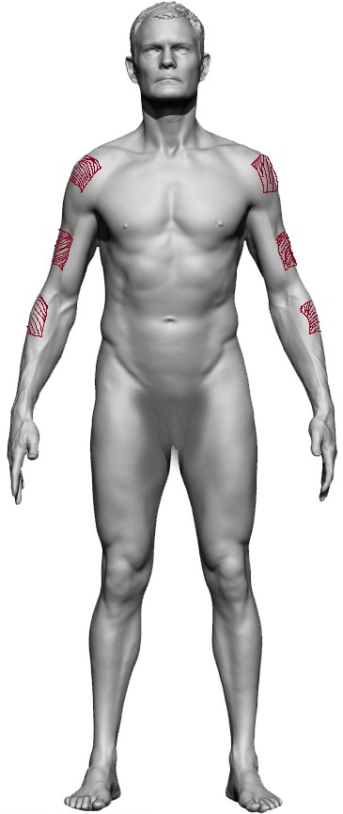
Skin care product experiment again
6 healthy volunteers
Male 1 | Age 21 | Dark skin type
Female 1 | Age 42 | Dark skin type
Male 2 | Age 46 | Dark skin type
Male 3 | Age 29 | Light skin type
Female 2 | Age 24 | Light skin type
Female 3 | Age 32 | Light skin type
4 products need to be tested
How to assign products to spots?
What if you want to provide 2 different sun exposure regimes?
What if there are 5 products to test?
What if the 4 products are 2 active ingredients combined with 2 carriers?
Suppose Male 2 and 3 are smokers. Would that affect your plan?
Can apply products on 3 spots on each arm (2 on upper, one on lower arm)
Apply products daily for a week,
expose arms to the sun and
assess after day 4 and after day 7 redness, itchiness and numbness
After 2 months, a second treatment period of a week

Slide 7
Demos on incomplete blocks
Principles for balance:
Balanced: all treatments same number of times, have all pairs combined in same number of times in a block
Balanced incomplete block design via R library agricolae (restricted number of situations possible)
Partially balanced incomplete block designs (e.g. cyclic designs): even then not easy
Optimal design (D optimal blocking) via R library AlgDesign
Randomisation

Slide 8
Optimal Design in a nutshell
Uses computing force and trial-and-error to find designs instead of clever algorithms
Decide on a criterion that has to be optimized
Generate plenty of possible designs and calculate criterion
Picks the design which scores best
Examples of criteria
Determinant of the information matrix: the higher this is, the more precise estimates will be. Ideal if you need a design to estimate something. [D-optimality]
The avarage prediction variance: the smaller this, the more precise predictions will be. Ideal if need a design to predict something [I-optimality]
...
Randomisation

Slide 9
Lessons learned
Randomisation is the basis for proof of causation.
Orthogonality is the basis of efficient analysis.
Full randomization wil seldom lead to the most efficient design.
Compromise between steering balance while keeping degree of randomness.
Blocking is a fine way to do so.
Complete blocks are very unlikely to be best choice.
Follow the principles of blocking rather than recipes for blocking.
If you don’t want to do it by hand, optimal design is your most flexible tool to achieve this.
Recognize confounding. Use confounding if it can serve your goal.
Randomisation

Slide 10
analysis
simulations
Concepts and principles:
Confounding, blocking and randomisation
More formal design
Quantification of variance components
Power analysis
Optimal design
Real cases: your cases
Factorial designs

Slide 11
3
4
analysis
simulations
Concepts and principles:
Confounding, blocking and randomisation
2
1
More formal design
Quantification of variance components
Power analysis
Optimal design
1
Live online
3
4
R markdown + live follow-up
5
6
Youtube movie
Real cases: your cases
Factorial designs
7
8

Slide 12
Appointment every Thursday morning for about 2 h
schema | Dates | content
1 | 30/4 | live
2 | 30/4-7/4 | markdown 1
 | 7/5 | discussion markdown 1 + introduction movie
3&4 | 7/5-14/5 | movie + markdown 2
 | 14/5 | discussion movie and markdown 2
5&6 | 22/5 | intro to movie and markdown 3
 | 22/5-29/5 | movie + markdown 2
 | 29/5 | discussion movie and markdown + introduction markdown 4
7 | 29/5-5/6 | markdown 4
 | 12/6 | discussion markdown 4 + presentation own cases
8 | 17/6 | discussion own cases

Slide 13
Essential concepts:
Randomisation
Replication
Orthogonality
+ some handy tools:
Balancing
Blocking
Random effects

Slide 14
Constraints old days
For easy calculation at the data analysis stage, designs need to be perfectly orthogonal and balanced.
Only a limited number of designs fulfil these criteria, are given a name and collected in recipe book style manuals.
Main role of statistician is to see if the appropriate design has been chosen (because plenty of recipes to choose from)
Situation is clear and easy
Introduction

Slide 15
Nowadays (since 30+ years)
Thanks to computers and new algortihms, we can live with almost-orthogonal designs, with unbalanced designs, incomplete blocks, dependent observations,...
Therefor there is far more flexibility in designing experiments.
This leads to the possibility to optimize the use of resources.
We have better options to fulfil other model assumptions.
We can perform more informative data analysis.
…
But less clear and easy. We need to think and understand…
Yet still a lot of old school designs (education, journal editors, research leaders, lack of modern statisticians...)
Introduction

Slide 16
 |  | N
 |  | 0 | 15 | 30
P | 0 | 2 | 2 | 2
 | 5 | 2 | 2 | 2
 | 10 | 2 | 2 | 2
If n = 22, this one is probably more efficient
 |  | N
 |  | 0 | 15 | 30
P | 0 | 2 | 3 | 2
 | 5 | 3 | 3 | 3
 | 10 | 2 | 2 | 2
If N=0 and P=0 is likely to fail dramatically,
this one is probably better
Or this one…
 |  | N
 |  | 0 | 15 | 30
P | 0 | - | 3 | 3
 | 5 | 2 | 3 | 3
 | 10 | 2 | 3 | 3
 |  | N
 |  | 0 | 15 | 30
P | 0 | - | 2 | 3
 | 5 | 2 | 3 | 3
 | 10 | 3 | 3 | 3

Slide 17
Randomisation and balancing
Randomization is the reason why experiments can proof causation.
Orthogonality of factors enables the analysis to separate the effects of each factor.
Balancing is a way to create orthogonality.
A random assignment does not guarantee a balanced design.
Find a compromise
A sufficiently random and as much as possible balanced design
Be prepared to make sacrifices in objectives
Randomisation

Slide 18
Blocking
Grouping to create more homogenous sets of units that come from a population affected by uninteresting but important sources of variability
Within a block, units are more equal (and even considered the same) than units from different blocks
A mean to reduce the remaining uncontrollable variability (see later)
Introduction

Slide 19
Find a compromise between
randomization and balancing
A sufficiently random and as much as possible balanced design
Blocking is a tool to do this
A block = homogenous sub-division
Complete blocks
Incomplete blocks
Unequally sized blocks
But not the only tool
Randomisation

Slide 20
Covariates
Factors that are not the main objective of the experiment, but may affect the observations.
Can act directly on response, can alter the response to experimental factors or can change variability.
Are controllable or measurable
We may do something intelligent with them at the moment of data analysis
Introduction

Slide 21
Confounding
Either…
Avoid at all cost (orthogonality remember!)
or
Deliberately combine factors to simplify things while keeping broadness of the setting
Randomisation

Slide 22
The stage of the research
Generalizability
Precision - Specificity
Tight control – articifical – miminize variability – focus on estimate of effects
Allow variability - representative – robustness – spread of effects
Research path
Introduction

Slide 23
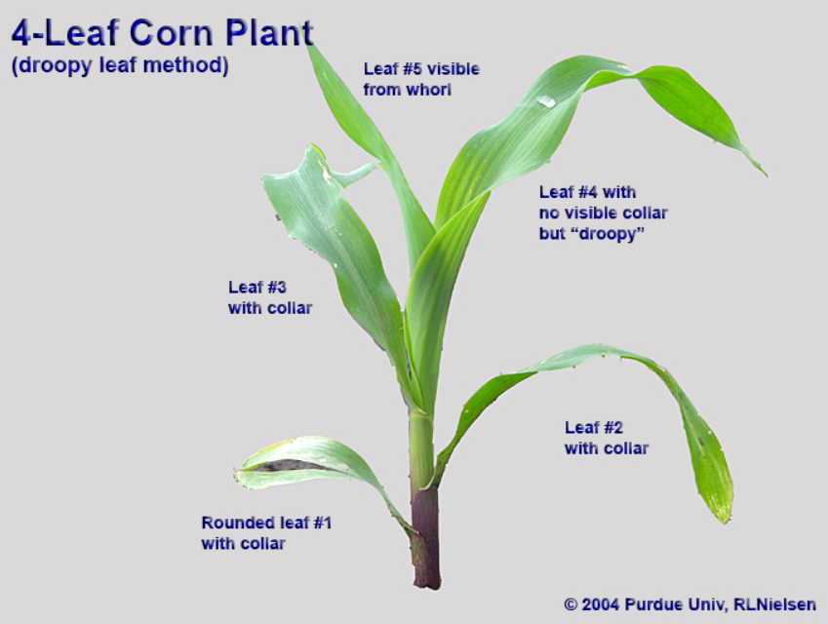
Greenhouse experiment
Greenhouse table
light
Window facing South
irrigation
pot

Slide 24
Skin care product experiment
6 healthy volunteers
Male 1 | Age 31 | Dark skin type
Female 1 | Age 42 | Dark skin type
Male 2 | Age 27 | Dark skin type
Male 3 | Age 29 | Light skin type
Female 2 | Age 24 | Light skin type
Female 3 | Age 38 | Light skin type
Can apply products on 3 spots on each arm
After 2 months, a similar treatment period of a week

Slide 25
The Greenhouse experiment again
Research Question: Does phytochrome A (per gram dry biomass) depend on soil fertility?
Two soil types R or P
three maize varieties ‘fast’, ‘very fast’ and ‘slow’
Greenhouse table
What is the role of the varieties?
How do you assign soils and varieties to pots?
What if there are 4 varieties?
What if you want to provide 2 different watering regimes?
Is it important to consider the role of the soil in the experiment objectives?
Soil R stand for “rich” and soil P for “poor”. Does this affect your randomization plan?
light
Window facing South
irrigation
pot
Randomisation

Slide 26
Skin care product experiment again
6 healthy volunteers
Male 1 | Age 21 | Dark skin type
Female 1 | Age 42 | Dark skin type
Male 2 | Age 46 | Dark skin type
Male 3 | Age 29 | Light skin type
Female 2 | Age 24 | Light skin type
Female 3 | Age 32 | Light skin type
4 products need to be tested
How to assign products to spots?
What if you want to provide 2 different sun exposure regimes?
What if there are 5 products to test?
What if the 4 products are 2 active ingredients combined with 2 carriers?
can apply products on 3 spots on each arm for one week, and after two months they go through a second treatment period of a week
expose arms to the sun and
assess after day 4 and after day 7 redness, itchiness and numbness

Slide 27
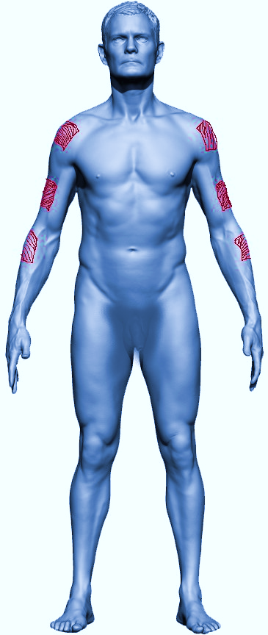
M 21y
F 42y
M 46y
M 29y
F 24y
F 33y
Period 1

Slide 28
Design ⬄ Analysis

Slide 29
Research cycle
Testable hypotheses
Designed experiment
Research question
Execution/
data collection
Communication/
action/decision
Conclusion
Data analysis

Slide 30
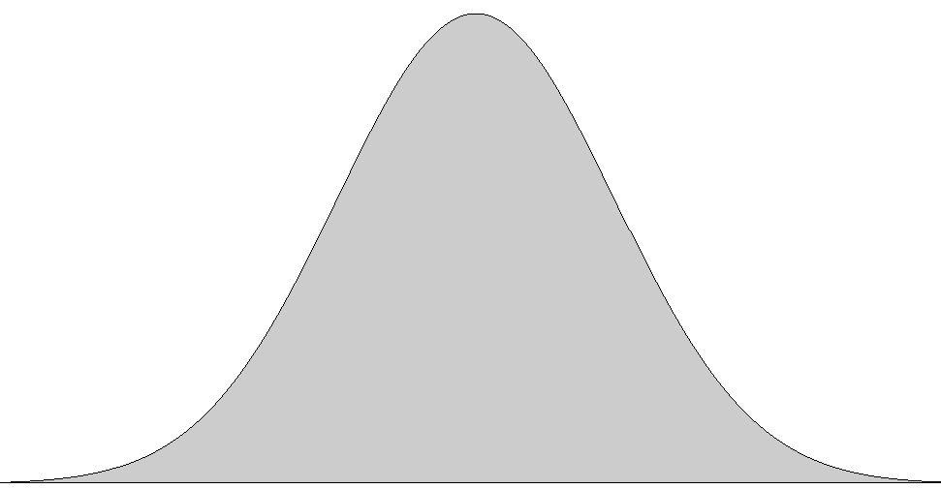
Data = signal + noise
A₁ vs A₂ : t-test
A₁ vs A₂ vs A₃ : anova
Anova is a standard method to compare several means.
So why is anova called anova?
=
+
+
+
R = T – A – U₁ – U₂
variability
interesting factor A
variability
uninteresting but known factor U₁
variability
uninteresting but known factor U₂
remaining unknown variability R
$$\frac{A}{R}$$
total variability T
$$\frac{A/levels}{R/df}$$
variability

